Slide 1
Lecture 3,4

Slide 2
Agenda
7
Stakeholders
Types of stakeholders
Requirement types
Problem Domain/Solution Domain

Slide 3
Stakeholders
A stakeholder of a system is a person or an organization that has an (direct or
indirect) influence on the requirements of the system.

Slide 4
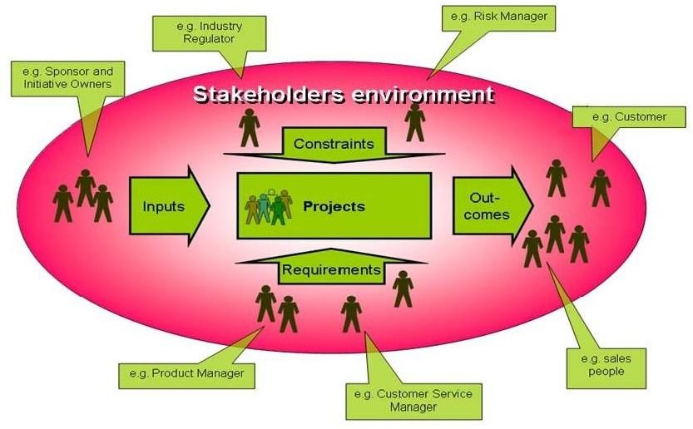
Context: Stakeholder's Environment
14

Slide 5
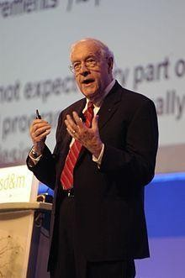

Importance of Software Requirements[9]
15
The hardest single part of building a software system is deciding what to build….. No other part of the work so cripples the resulting system if done wrong. No other part is difficult to rectify later. (Fred Brooks)

Slide 6
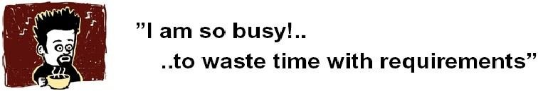
The Root Causes of Project Success and Failure[1]
16
The first step in resolving any problem is to understand the root causes.
The 1994 Standish Group survey study noted the
three commonly cited factors that caused projects to be
"challenged":
Lackof user input: 13 percent of all projects
Incomplete requirements and specifications: 12 percent of all projects
Changing requirements and specifications: 12 percent of all projects

Slide 7

The Root Causes of Project Success and Failure
17
Thereafter, the data diverges rapidly. Of course, your project could fail
cited
because of an
unrealistic schedule or time frame (4
percent of the projects this),
inadequate staffing and resources (6 percent),
inadequate technology skills (7 percent), or various other reasons.
The survey shows that at least a third of development projects run into trouble for reasons that are directly related to requirements gathering, requirements documentation, and requirements management.

Slide 8

The Root Causes of Project Success and Failure[1]
18
Although
the majority of
projects do seem to experience
schedule/budget overruns,
the Standish Group found that 9
percent of the projects in large companies were delivered on time and on budget; 16 percent of the projects in small companies enjoyed a similar success. That leads to an obvious question: What were the primary "success factors" for those projects?
According to the Standish study, the three most important factors
were
User involvement: 16 percent of all successful projects

Slide 9
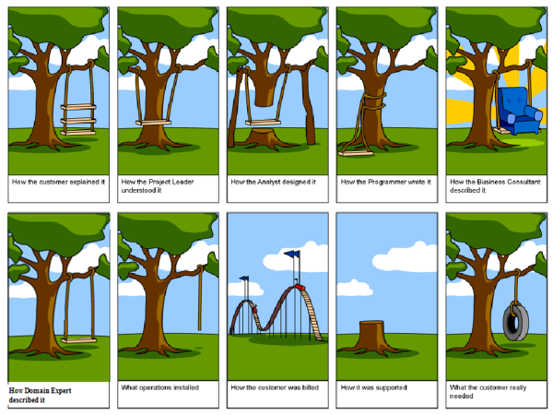
Importance of Requirement

Slide 10
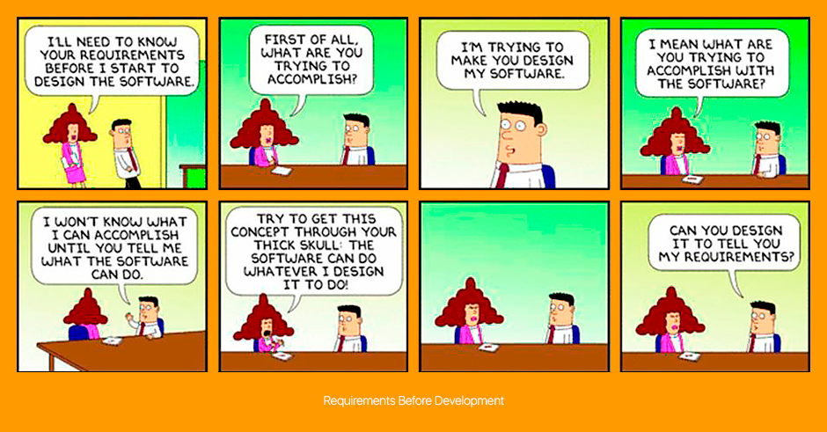
Importance of Requirements

Slide 11
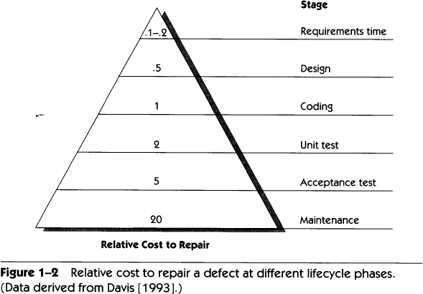
High Cost of Requirement Errors[1]
21
If a unit cost of one is assigned to
the effort
required to detect
and repair anerror during the coding stage ….

Slide 12
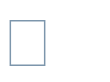
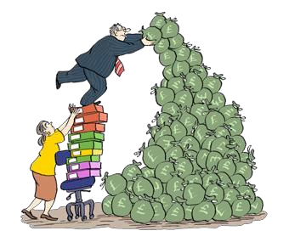
High Cost of Requirement Errors[1]
22
The errors discovered during the design of a development
project could
fall into one of two categories:
errors that occurred when the development staff created a technical
design from a correct set of requirements or
errors that should have been detected as requirements errors somewhat earlier in the process but that somehow "leaked" into the design phase of the project.

Slide 13

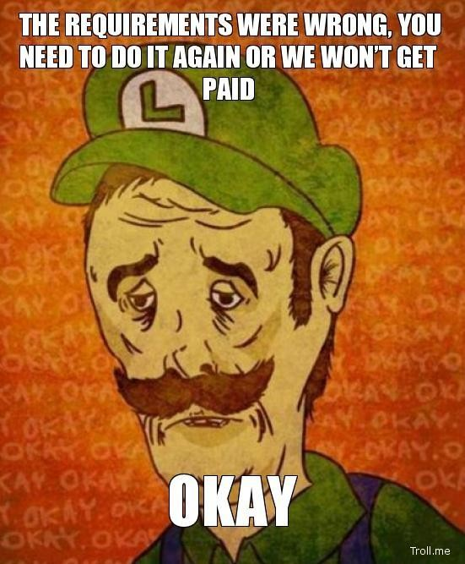
High Cost of Requirement Errors[1]
23
It's the latter category of errors that turn out to be particularly expensive, for two reasons.
By the time the requirements-oriented error is discovered, the development group will have invested time and effort in building a design from those erroneous requirements. As a result, the design will probably have to be thrown away or reworked.
The true nature of the error may be disguised; everyone assumes that they're looking for design errors during the testing or inspection activities that take place during this phase, and considerable time and effort may be wasted until someone says, "Wait a minute! This isn't a design mistake after all; we've got the wrong requirements.―

Slide 14
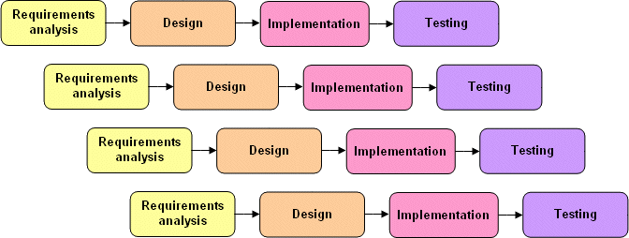


High Cost of Requirement Errors- Defect Leakage [1]
25
whenever a defect is discovered in a software application,
likely to experience the effect of 50–100 times cost.
we're
Re-specification.
Redesign. Recoding.
Retesting. Change orders Corrective action

Slide 15
GOAL OF REQUIREMENTS ENGINEERING
During the development process, requirements engineering must elicit the
stakeholders’ requirements,
document the requirements in a suitable manner,
validate and verify the requirements,
and manage the requirements
over the course of the entire life cycle of the system

Slide 16
Requirement Engineering
Definition 1-3: Requirements Engineering
(1) Requirements engineering is a systematic and disciplined approach to the
specification and management of requirements with the following goals:
(1.1) Knowing the relevant requirements, achieving a consensus among
the stakeholders about these requirements, documenting them
according to given standards, and managing them systematically
(1.2) Understanding and documenting the stakeholders’ desires and
needs, they specifying and managing requirements to minimize the
risk of delivering a system that does not meet the stakeholders’
desires and needs

Slide 17
The four core activities
Elicitation: During requirements elicitation, different techniques are
used to obtain requirements from stakeholders and other sources and
to refine the requirements in greater detail.
Documentation: During documentation, the elicited requirements are
described adequately. Different techniques are used to document the
requirements by using natural language or conceptual models (see
chapters 4, 5, and 6).
Validation and negotiation: In order to guarantee that the predefined
quality criteria are met, documented requirements must be validated and
negotiated early on (see chapter 7).
Management: Requirements management is orthogonal to all other
activities and comprises any measures that are necessary to structure
requirements, to prepare them so that they can be used by different
roles, to maintain consistency after changes, and to ensure their implementation
(see chapter 8).

Slide 18
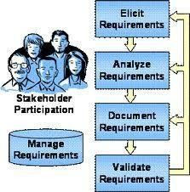
Requirements Engineering Process
27
Elicitation: work with the customer on gathering requirements
Analysis: process this information to understand it, classify in various categories, and relate the customer needs to possible software requirements
Specification: Structure the customer input and derived requirements as written documents and diagrams
Validation: you’ll ask your customer to confirm that what you’ve written is accurate and complete and to correct errors.

Slide 19
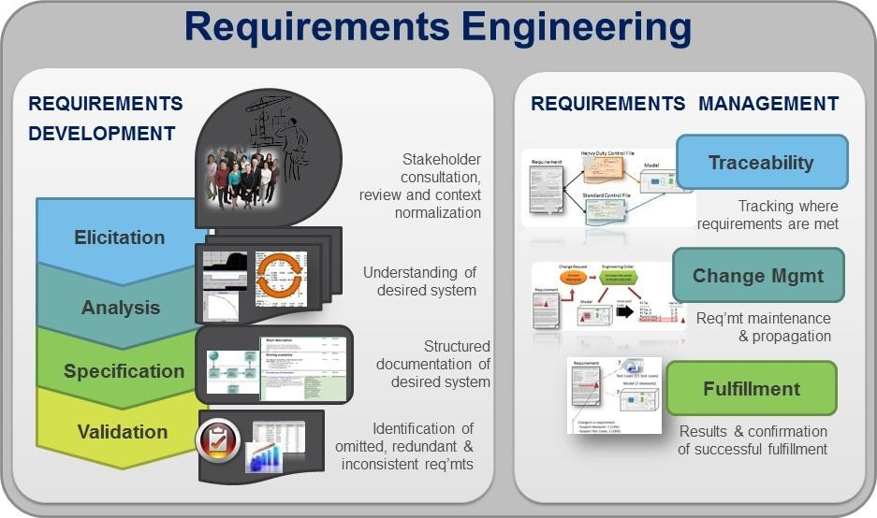
Requirements Management[10]
28
Requirements | management | is | the | process | of
documenting, | analyzing, tracing, | prioritiz | ing | and agreeing | on
requirements and then relevant stakeholders.
controlling change and communicating to
ed

Slide 20
Types of Software Apps
29
Information Systems
Commercial Software Apps
Embedded Systems

Slide 21
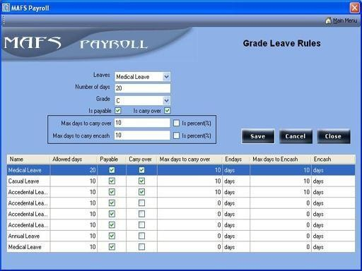
Types of Software Applications [1]
30
Information Systems
Information systems and other applications developed for use within a company (such as the payroll system being used to calculate the take- home pay for our next paycheck). This category is the basis for the information system/information technology industry, or IS/IT.

Slide 22


Types of Software Applications [1]
31
Commercial SoftwareApplications
Software developed and sold as commercial products (such as the MS Office). Companies developing this type of software are often referred to as independent software vendors, or ISVs.

Slide 23
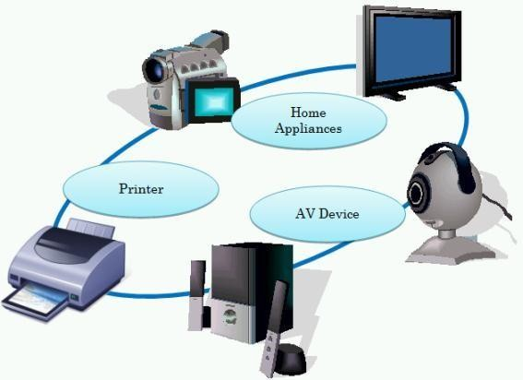
Types of Software Applications [1]
32
Embedded Software's
Software that runs on computers embedded in other devices, machines, or complex systems (such as those contained in the airplane, in cell phones, in washing machines, in ovens, the automobile and many more…….) This type of software's are known as software embedded-systems applications, or embedded applications.

Slide 24
Types of Software Requirements
33
Functional requirements and Non-functional requirements
User and system requirement
Domain requirements
Inverse requirements
Design and implementation constraints

Slide 25
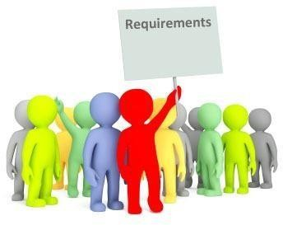
Functional Requirements [2]
34
In software engineering, a functional requirement defines a function of a software
system or its component.
Backbone of Requirements
A function is described as a set of inputs, the behavior, and outputs.
Functional requirements may be calculations, technical details, data manipulation and processing and other specific functionality that define what a system is supposed to accomplish.
Functional requirements are the statements and services that system should provide in two clearly described external behaviors
Reaction to particular input (e.g give some input to software and it produces a result)
Behavior in particular situations (e.g If I click on an exit button then system behaves in
a particular way)

Slide 26
Functional Requirements [2]
35
Functional Requirements can be stated from either static or dynamic
perspective
The dynamic perspective describes the behavior of the system in terms of results
The static perspective describes the functions performed by each entity and the way each interacts with other entities and the environment
Abnormal behavior is also documented as functional requirements in the form of exception handling
Functional requirements should be complete and consistent
Customers and developers usually focus all their attention on functional requirements

Slide 27
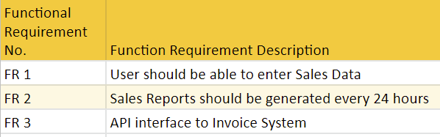
Example of Functional Requirement

Slide 28
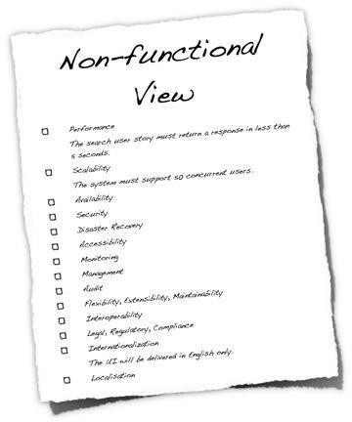
Non-Functional Requirements [3]
36
In requirements engineering, a non- functional requirement
is a requirement that specifies
criteria that can be used to judge the operation of a system, rather than specific behaviors.
Non-functional requirements are often called qualities of a system. Other terms for non-functional requirements are "constraints", "quality attributes", "quality goals", "quality of service requirements" and "non-behavioral requirements".
Informally these are sometimes called the "ilities", from attributes like stability and portability.

Slide 29
Non-Functional Requirements (NFR)
37
Types | Explanation
Product requirements: | specify that the delivered product mustbehave in a particular way e.g. execution speed, reliability, etc.
Organizational requirements: | are a consequence of organizational policies and procedures e.g. process standards used, implementation requirements, etc.
External requirements: | arise from factors which are external to the system and its development process e.g. interoperability requirements, legislative requirements, etc.

Slide 30


















Non-Functional Requirements
38
Non-functional requir ements
Product
Or ganizational
External
requirements
requirements
requirements
Efficiency
Reliab ility
Portability
Interoperability
Ethical
requirements
requirements
requirements
requirements
requirements
Usability
Delivery
Implementation
Standards
Legislative
requirements
requirements
requirements
requirements
requirements
Performance
Space
Privacy
Safety
requirements
requirements
requirements
requirements

Slide 31
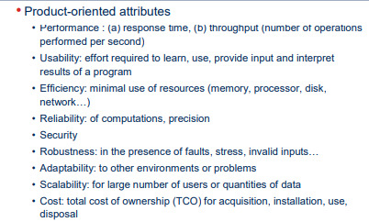
NFR

Slide 32
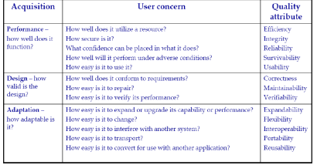
Another Classification

Slide 33
User Requirement
Written for users who aren’t expert of Software Fields
Highlights the overview of the system without design description
It specifies
Functional requirement
Constraints
Quality
External Behavior

Slide 34
Design and Implementation Constraints
41
They are development guidelines within which the designer must work
These requirements can seriously limit design and implementation options
Can also have impact on human resources

Slide 35
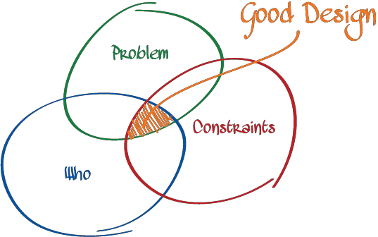


Example
Example:
The system shall be developed using the Microsoft .Net platform
The system shall be developed using open source tools and shall run on
Linux operating system
The System should be implemented using C sharp language
The software must fit into the memory of a 512Kbyte machine.

Slide 36
System Requirements
Design from user requirement or expanded form of user requirement
Used as input to designer so that they can prepare the SDD

Slide 37
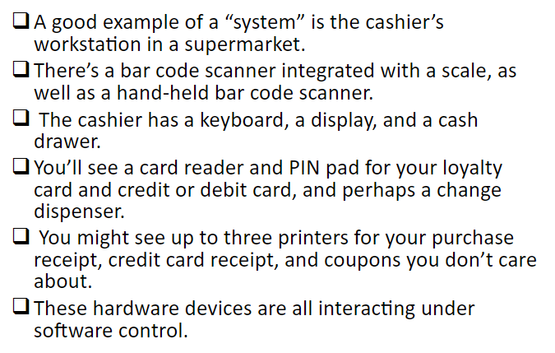
Example

Slide 38
Domain Requirements[8]
39
Requirements that and reflect domain
come from the application domain fundamental characteristics of that application
These can be both the functional or non-functional requirements
These requirements, sometimes, are not explicitly mentioned
Their absence can cause significant dissatisfaction
Domain requirements can impose strict constraints on solutions

Slide 39
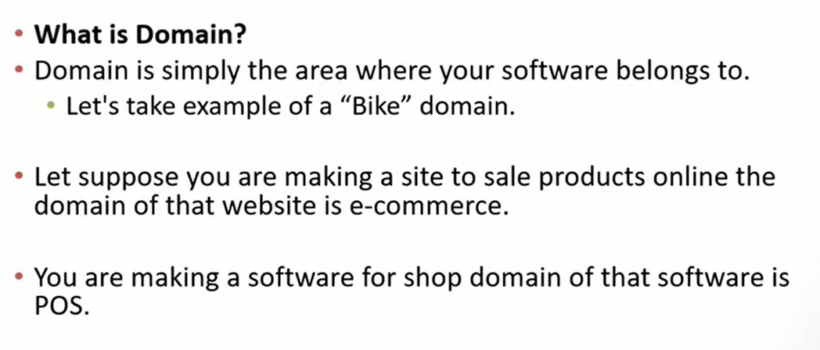
Example

Slide 40
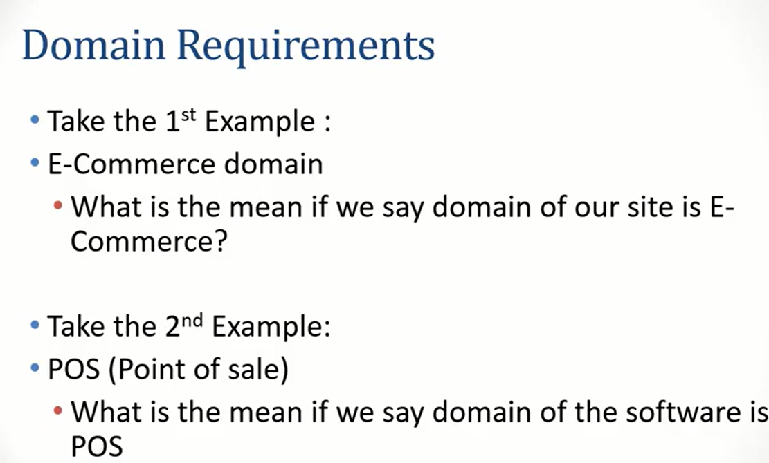
Example

Slide 41
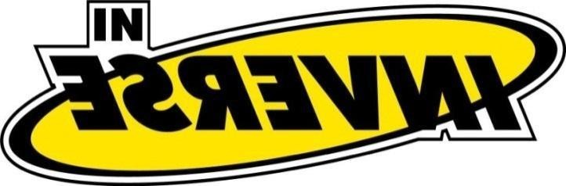



Inverse Requirements
40
They explain what the system shall not do.
Inverse requirements describe the constraints on the allowable behaviors
Many people find it convenient to describe their needs
in this manner
These requirements indicate the indecisive nature of customers about certain aspects of a new software product
The system shall not use red color in the user interface, whenever it is asking for inputs from the end-user
Safety and security requirements are usually stated in this manner

Slide 42
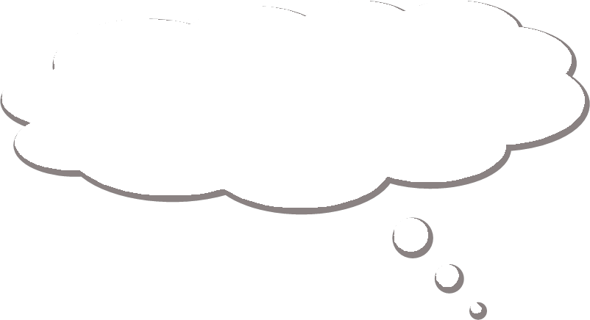



Problem Domain [1]
Problem Domain
42
Most successful requirements journeys begin with a trip to the land of problem.
This problem domain is the home of real users and other stakeholders, people whose needs must be addressed in order for us to build the perfect system.
This is the home of the people who need the rock or a new sales order entry system or a configuration management system good enough to blow the competition away.
In all probability, these people are not like us. Their technical and economic backgrounds are different from ours.
On rare occasions, they are just like us. They are programmers looking for a new tool or system developers who have asked you to develop a portion of the system.

Slide 43


Problem Domain [1]
43
These users have business or technical problems that
they need our help to solve.
Therefore, it becomes our problem to understand their problems, in their culture and their language, and to build systemsthat meet their needs.
Within the problem domain, we use a set of team skils to gain an understanding of the problem and the needs that mustbe filled to address this problem.

Slide 44
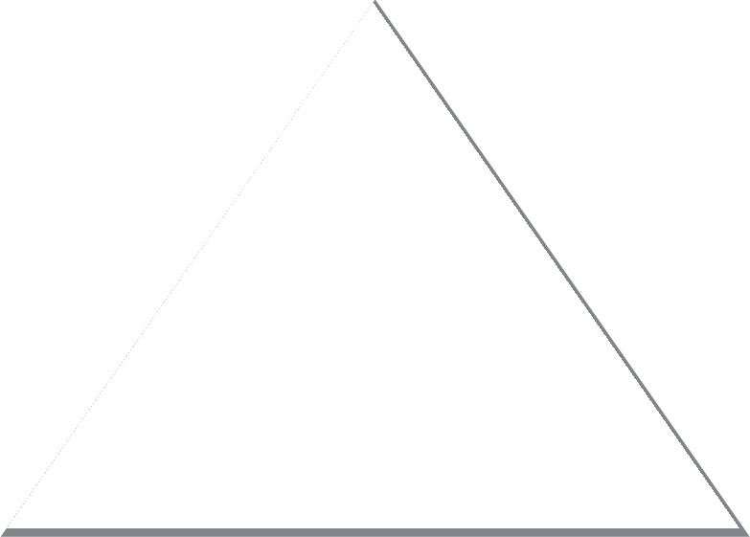
Stakeholder Needs [1]
44
Stakeholders are people who have a stake or interest in the project
It is also our responsibility to understand the needs of usersand other
stakeholders whose lives will be affected by our solution.
As we elicit those needs, we'll stack them in a little pile called stakeholder needs, which we represent as a pyramid.
Needs

Slide 45
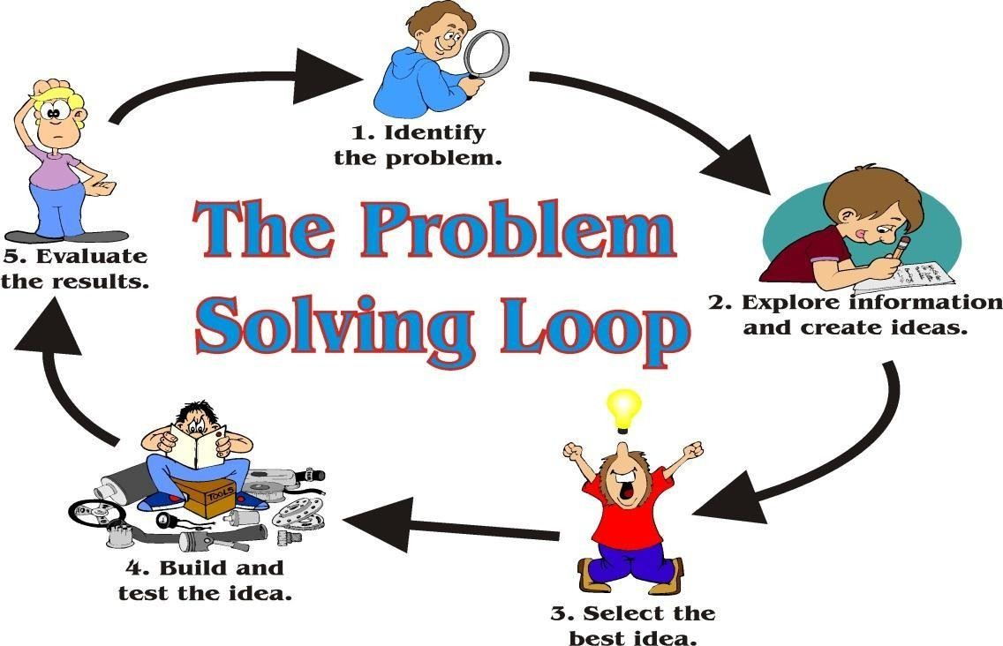
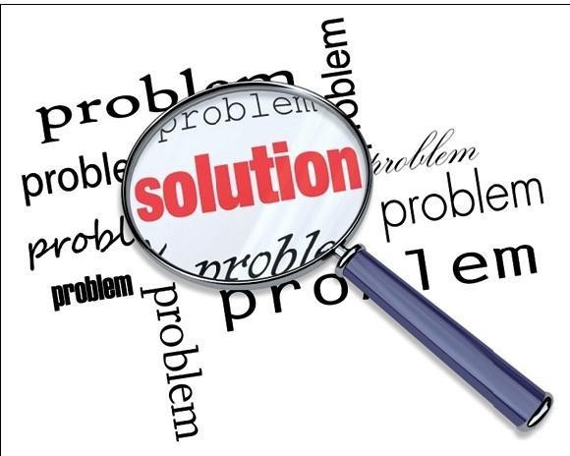
Moving towards the solution domain [1]
45
We move to Solution domain from the problem domain in order to provide a solution to the problem at hand.
In the solution space, we focus on defining a solution to the user's problem; this is the realm of computers, programming, operating systems, networks, and processing nodes. Here, we can apply the skils we have learned muchmore directly.

Slide 46
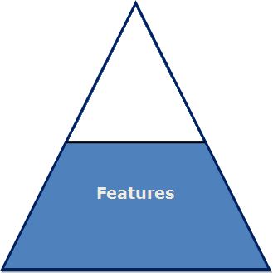

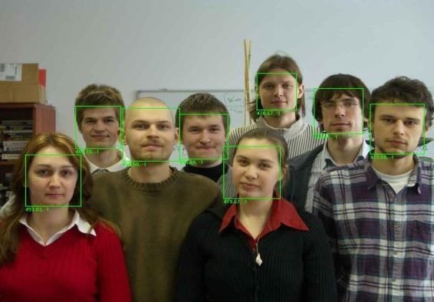
Moving towards the solution domain [1]
46
Features of the System
a service provided by the system that fulfills one or
more stakeholder needs.
Thislist could consists of suchitems as thefollowing.
"The car will have power windows.―
"The cell provides pattern to lock screen"
―TheAttendance of students will be enrolled recognition ."
through face
These are simple descriptions, in the user's language, that we will use as labels to communicate with the user how our system addresses the problem.

Slide 47
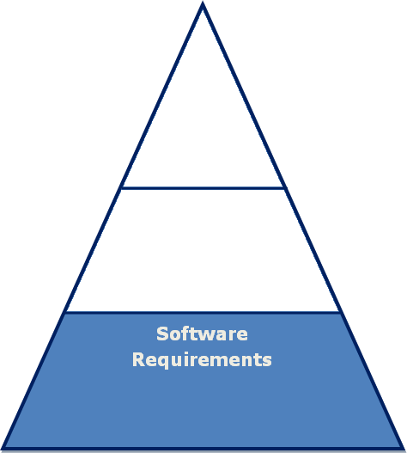
Moving towards the solution domain [1]
47
Software Requirements
Once we have established the feature set and have gained agreement with the customer, we can move on to defining the more specific requirements we will need to impose on the solution.
If we build a system that conforms to those requirements, we can be certain that the system we develop will deliver the features we promised. In turn, since the features address one or more stakeholder needs, we will have addressed those needs directly in the solution.
These more specific requirements are the software requirements.

Slide 48
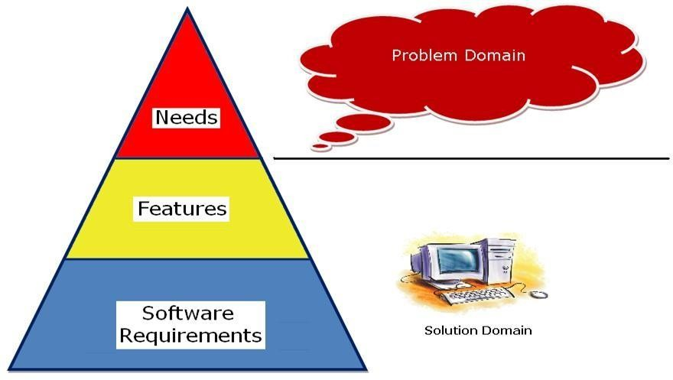
Overview of the Problem Domain and Solution Domain[1]
48
We have moved from the problem domain, represented by the user needs we discovered, to a definition of a system that will constitute the solution domain, represented by the features of the system and the software requirements that will drive its design and implementation.

